Slide 1
Improved Recognition of Inpatient Hypercapnic Respiratory Failure
Brian Locke, MD
T32 Fellow
Division of Pulmonary, Critical Care, and Occupational Pulmonary Medicine
Department of Internal Medicine
University of Utah School of Medicine
This research was supported by the National Institutes of Health under Ruth L. Kirschstein National Research Service Award 5T32HL105321 from the NIH
and The American Thoracic Society through the Academic Sleep and Pulmonary Integrated Research/Clinical Fellowship (ASPIRE) Program

Slide 2
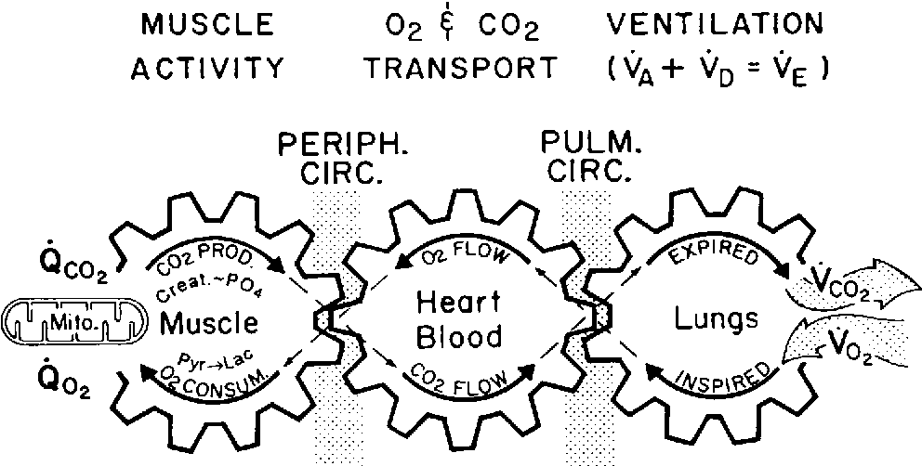
Hypercapnic Respiratory Failure
Build up here = CO2 in blood rises
Hypoxemic (Low O2) Respiratory Failure | Hypercapnic (High CO2) Respiratory Failure
Low arterial blood oxygen tension | High arterial blood carbon dioxide tension
(Relatively) Reliably Identified by Pulse Oximetry | No routine non-invasive testing
Patients with hypercapnia are identified unreliably and late in their illness
Notes:
There are two purposes to the respiratory system: get enough oxygen to the blood, and get enough CO2 out of the blood.

Slide 3

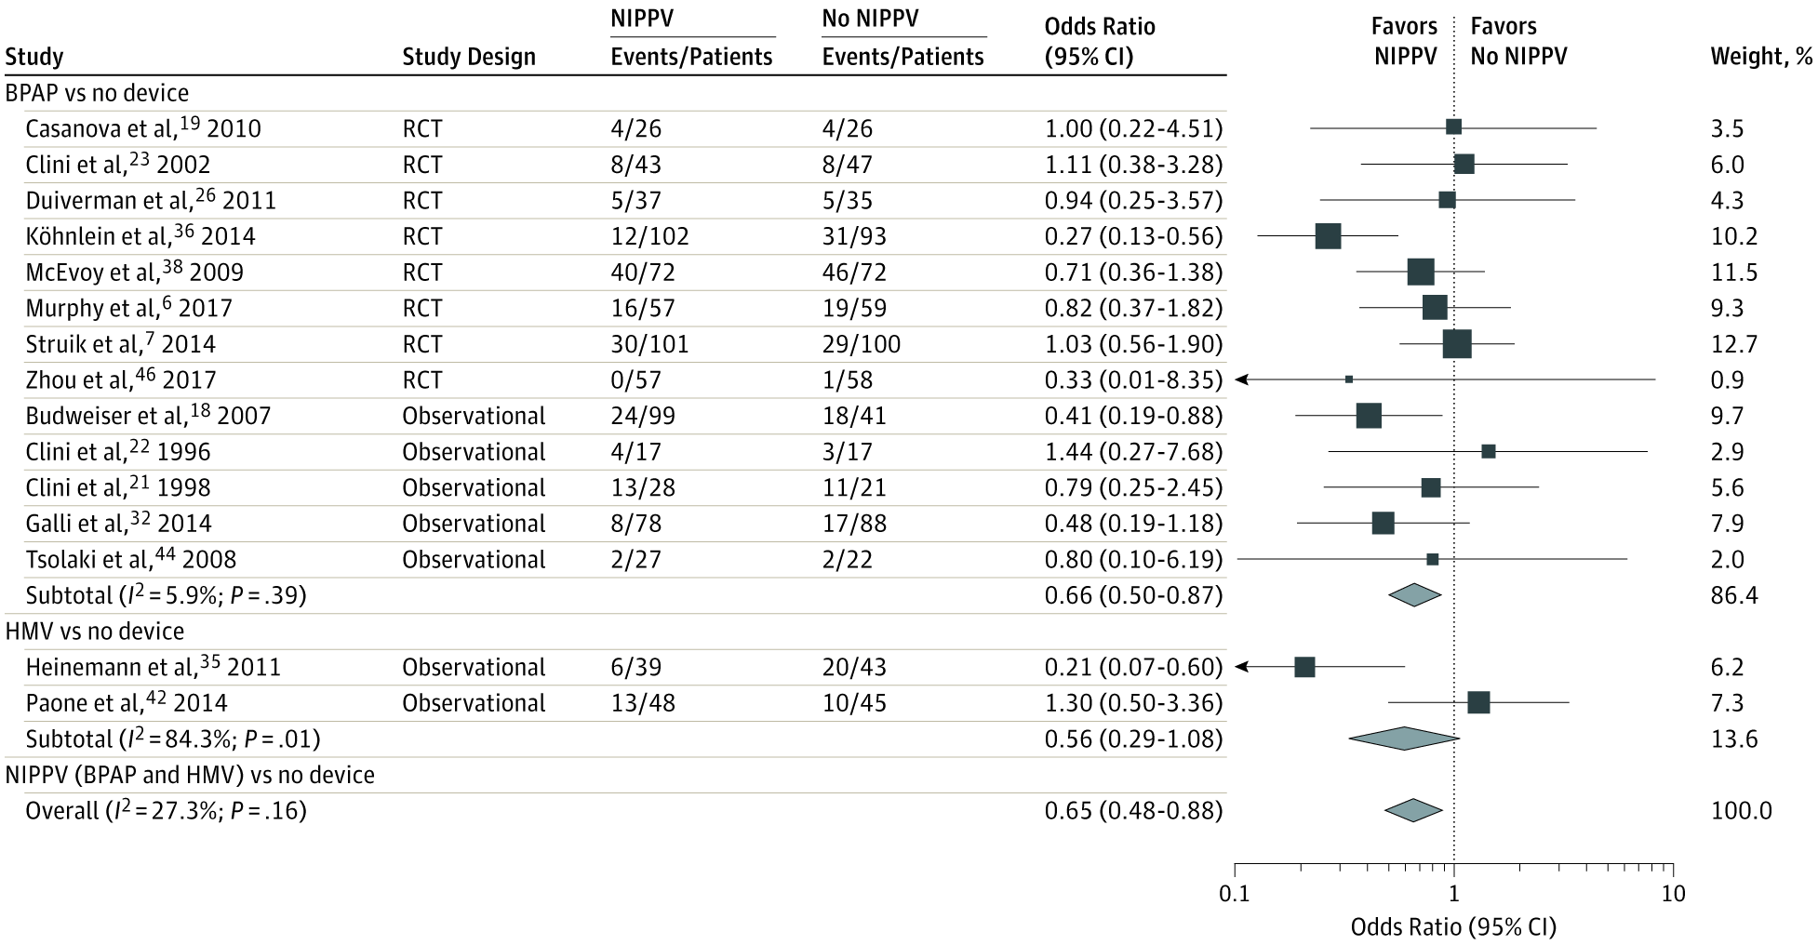

Hypercapnia is common, is probably becoming more common, and is treatable.
Common contributors to Hypercapnic Respiratory Failure:
Advanced Age
Opiate Use
Obesity
Advanced Lung Dz
Multimorbidity
E.g.: Home PAP improves mortality in ↑CO2-COPD
Weight loss
Medication Adjustment
Pulmonary Rehab
Population-standardized prevalence PaCO2 > 45 mmHg after excluding iatrogenic causes:
150* per 100,000 person/year
*Only inpatients, only those with blood gasses checked
Comparison: Decompensated Cirrhosis 94.9 (US, 2017) per 100,000 person year
Notes:
JAMA. 2020;323(5):455-465. doi:10.1001/jama.2019.22343
Cirrhosis: https://www.ncbi.nlm.nih.gov/pmc/articles/PMC7026710/
US: 33·2 (HCV) + 26·5 (EtOH) + 10·3 (NASH) + 24·9 (Other) = 94.9 per 100,000 prevalence in the US
Patients with decompensated cirrhosis have a worse prognosis than do those with compensated cirrhosis; the average survival without transplantation is approximately two years [13,14]
Comparison seems apt, as you could think of hypercapnic respiratoyr failure as decompensated ventilation

Slide 4

By the time patients are caught: ↑morbidity
Inpatient ICD code for Hypercapnic Respiratory Failure
23% 30d readmission rate
  Same as CHF, more than MI
66% with recurrence
Decompensated Cirrhosis, for reference
Could we catch them earlier? Would it help?
Notes:
Lung Cancer survival rates https://seer.cancer.gov/statistics-network/explorer/application.html?site=47&data_type=4&graph_type=6&compareBy=sex&chk_sex_1=1&chk_sex_3=3&chk_sex_2=2&race=1&age_range=1&stage=101&advopt_precision=1&advopt_show_ci=on&hdn_view=0&advopt_show_apc=on&advopt_display=2#resultsRegion0
Roughly age normalized

Slide 5
Prior work:
 | Total | No ABG Obtained | ABG Obtained
N | 879,019 | 675,620 | 203,399
Ambulatory | 39% (343,699) | 50% (334,457) | 5% (9,242)
Emergency | 20% (175,792) | 22% (146,066) | 15% (29,726)
Inpatient | 41% (359,528) | 29% (195,097) | 81% (164,431)
Candidate Predictors (LASSO)
Age
Sex
Serum HCO3-
Serum Potassium
Serum Creatinine
Admitting Dx
Tool | Health Record-Based Modeling | Transcutaneous CO2
Purpose | Refine Estimation of Pre-test Odds of Hypercapnia | Allow non-invasive CO2 assessment (patients unlikely to consent for research ABGs)
Limitation | Approach only externally validated in outpatient OHS assessment | Prior 95% agreement +/- 6 mmHg insufficient for unstratified clinical use
Notes:
95% Agreement with PaCO2: +/- 6 mmHg, Bias +0.1 mmHg
Conway et al. Thorax 2019. SRMA 44 Studies (n=1786)

Slide 6

Aim 2: Prospective Validation of PPV
Aim 3: Evaluation of Prognostic Significance
Aim 1: Integration of NLP/LLM
Validation & Tuning
Probabilistic Modeling Likelihood of Hypercapnia

Slide 7
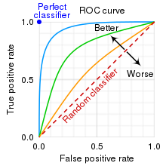
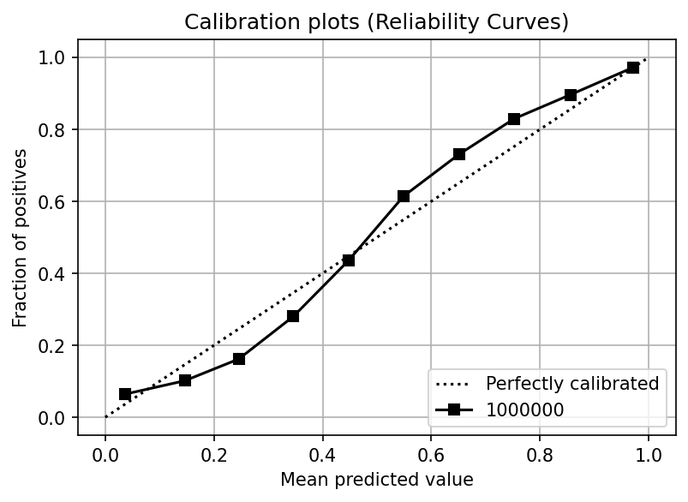
Aim 1: Optimize (and externally validate) local performance of statistical model
Apply TriNetX model to retrospective data from the University of Utah.
  Reference standard: patients who had arterial blood gasses obtained.
Add natural language processing using established tools / pipelines (CLAMP, LLM )
Adjust model weights
Generate measures of model performance (discrimination and calibration) to inform other aims

Slide 8
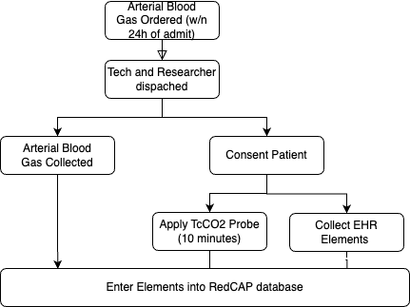
Aim 2: To estimate the prevalence of unrecognized hypercapnia in inpatients
Methods:
  Deferred consent (CO2 Narcosis)
  Verifying Positive Predictive Value (precision) in high-risk patients is more efficient than stratified sampling of the whole population.
    Aim = demonstrate possible benefit in highest risk, rathern than delineate scope of the probably (initially)
  Sample Size Calculation:
    25% ‘prevalence’ (Nowbar); model AUC; Se/Sp TcCO2 for true reference standard 85%/85%
How will this fail?
  Aim 1 results will influence needed sample size
  Can I access EHR data fast enough?
  Hawthorne effect? Due to hypoxemia (elevation), do they get identified earlier?

Slide 9
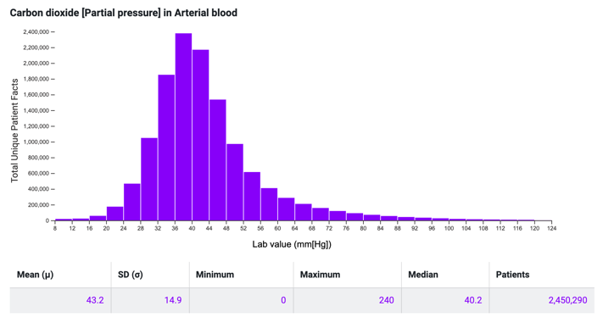
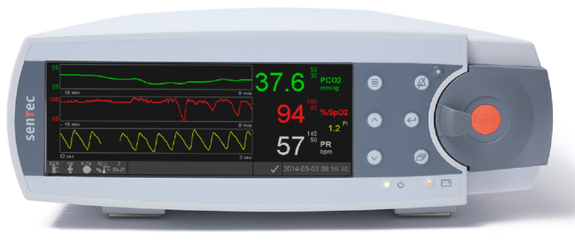
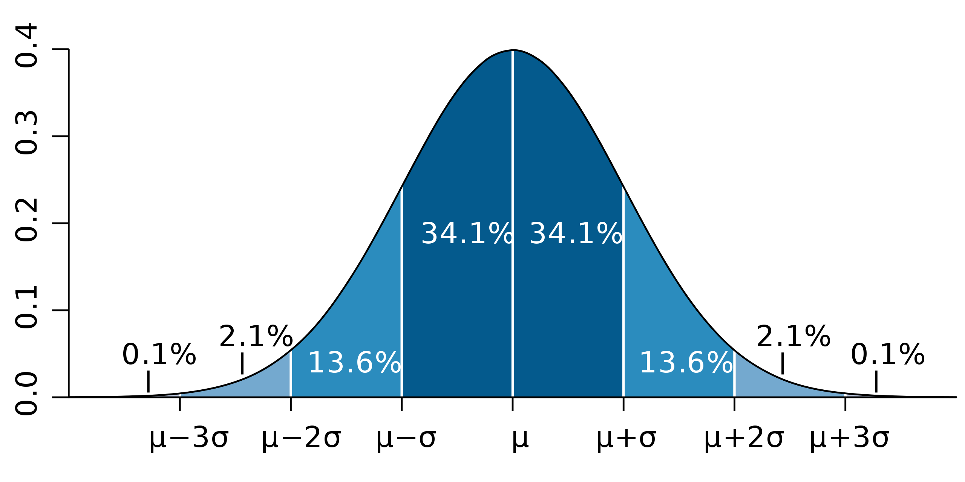
Prior work:
Nowbar et al. 2004: All w/ BMI ≥35 kg/m² admitted to inpatient medicine service at the Denver VA. Everyone (n=277) gets an ABG. 31% had hypercapnia. Only 1/3 of those had therapy started (teams were told)
Statistical Insights:
  Accuracy needed for clinical care ≠ Required accuracy for model verification
  Pre-test probability estimate allows stratified sampling → efficiency
…
49: Correct 93%, Wrong 7%: weight: 1.98%
48: Correct 88%, Wrong 12%: weight: 2.39%
47: Correct 80%, Wrong 20%: weight: 2.47%
46: Correct 69%, Wrong 31%: weight: 2.92%
45: Correct 57%, Wrong 43%: weight: 3.11%
SENSITIVITY
SPECIFICITY
44: Correct 57%, Wrong 43% 3.56%
43: Correct 69%, Wrong 31% weight 3.73
42: Correct 80%, Wrong 20% weight 4.16%
41: Correct 88%, Wrong 12% weight 4.25%
40: Correct 93%, Wrong 7% weight 4.58%
….
    Expected test characteristics:
    sensitivity = 89%
    specificity = 92%
    if
    agreement ~6 mmHg
    same distribution of CO2

Slide 10
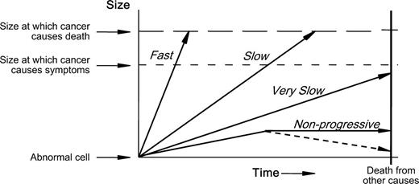
Aim 3: Estimate the potential impact of early & reliable identification
Might clinicians already identify intervenable cases?
Prior (limited) research:
  Marik et al. 2013: patient diagnosed with OHS are repeatedly admitted and missed diagnosed prior to their ultimate recognition
  Meservey et al. 2020: most readmissions are recurrence
Hypothesis: Patients predicted to have had hypercapnia that was not recognized have a similar or excess risk of subsequent readmission as those identified (by blood gas and/or ICD code)
Analogy to Cancer Screening
The diagnostic barnyard ‘fence’:
Birds won’t get caught
Turtles won’t benefit form being caught
Rabbits are the ones to focus on
Notes:
e.g. we don’t just want to focus on identifying more patients who would have a blood gas CO2 over 45 mmHg if it were checked… we want to identify the patients who have and are going to continue to have clinically important respiratory failure and, ideally, those who will benefit from known therapies.

Slide 11
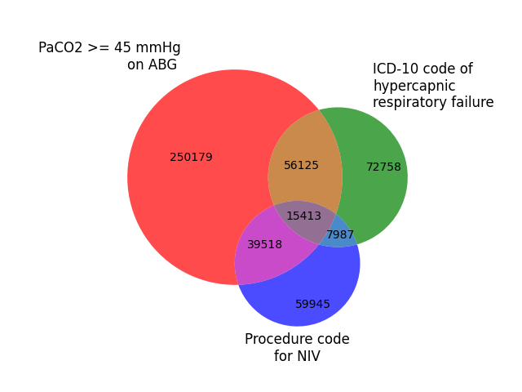
Aim 3: To estimate the potential impact of early & reliable identification
Study Design:
  Retrospective EHR-based review
  Dataset: Longitudinal, ideal self-contained system
  Exposures of interest:
    Hypercapnic Respiratory Failure by ICD code
    Hypercapnic Respiratory Failure by ABG (or by VBG) & not ICD code
    Predicted Risk of Hypercapnic Respiratory Failure by commonly-obtained data-elements
  Effect modifier: PAP/NIV therapy
  Outcome: Hazard of death or rehospitalization with hypercapnia
Threats to validity:
  Is it the hypercapnia risk, per-se? (negative controls)
  Risk might be ameliorated by treatment
  Risk among patients with hypercapnia is not binary [ie risk PaCO2=90 >>> 50]
Model predicted to have hypercapnia
Comparison in consequences
Those who likely had hypercapnia, but were not sampled

Slide 12
OVERALL: Patients with Consequentially Missed Hypercapnia can be Identified Using Health Record Elements | OVERALL: There is a significant burden of unrecognized hypercapnia among hospitalized patients. 3 aims
 | Aim 1: Model Refinement and Local Optimization | Aim 2: Prospective Validation | Aim 3: Assess Potential Impact
Hypothesis | Fine-tuning and refining previously derived model will improve local performance | Patients with hypercapnia that are not recognized are common can be identified using health record elements with high positive-predictive value. | Inpatients who were predicted, but not confirmed, to have hypercapnic respiratory failure are at high risk of adverse outcomes.
Rationale | The model should be optimized for local performance | Must be verified that model identifies unrecognized hypercapnia | Need to confirm that the identified patients face elevated risk (ABG PaCO2 is an imperfect reference standard).
Approach | Optimizing model performance +/- use of NLP tools) applied to U of U data | Non-invasively sample (with TcCO2) patients predicted to have hypercapnia that teams have not recognized | Among patients with an admission for hypercapnia that is identified, how many had preceding admissions likely to have hypercapnia?
Design | Retrospective, U of U | Prospective, U of U | Retrospective, VA
Payoff: This work will evaluate the potential for improved recognition of hypercapnia to help a particularly high-risk, enlarging, and understudied group of patients. Career Development: Prospective validations of bioinformatic tools require a unique skillset
Notes:
[ ] update this

Slide 13
Research Team:
Wayne Richards^{1,2} MS
Joseph Finkelstein² MD PhD MA
Jeanette Brown¹ MD PhD
Ramkiran Gouripeddi² MBBS MS
Krishna M Sundar¹ MD
Divisions of ¹Internal Medicine and ²Biomedical Informatics
Thanks for advice from: Robert Paine, MD; Barb Jones MD MSCI; Ken Kawamoto MD PhD MHS; MDCRC6450
Additional Questions
Handling of partial verification
Incorporation of Venous BG
Prospective validation logistics
Other modeling end-points
Realtime availability of data
VA aata access time/effort
PPV vs Se/Sp/Prevalence?
Socio-technological barriers
Sources of provider/unit/institution variation?
Brian.Locke@hsc.utah.edu

Slide 14
What is expected to come from this research?
Validation of a method of stratification that can be used to:
  Facilitate the identification of patients with high CO2 → improved patient care
  Identify patients with hypercapnia (± a verification method) for study inclusion → more representative cohorts of patients.
    Enable future studies assessing:
      Overall burden of disease from hypercapnic respiratory failure
      Effect of exposures (medications, environmental, policy) on risk of hypercapnia
      Test the effect of treatment interventions on broader types of high-risk patients.
Career-development:
Development of models (statistical, ML, etc.) exploding in healthcare
Bottle-neck is in prospective validation of uses, which takes a unique skillset to evaluate.

